Slide 1

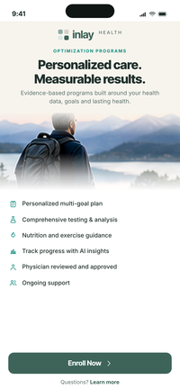
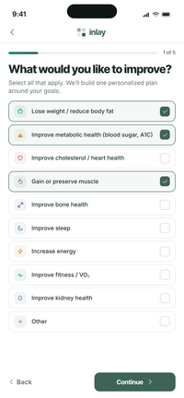
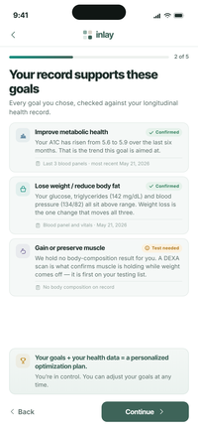
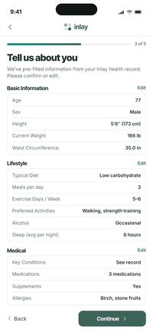
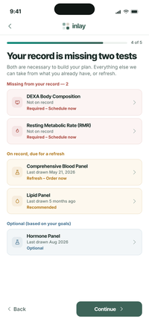
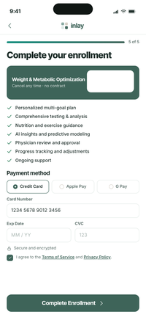
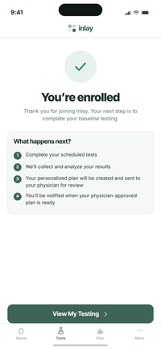
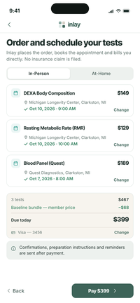
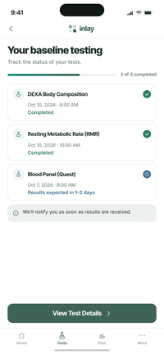
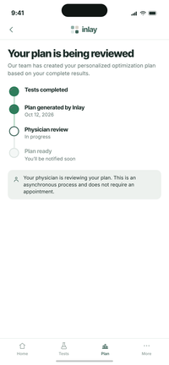
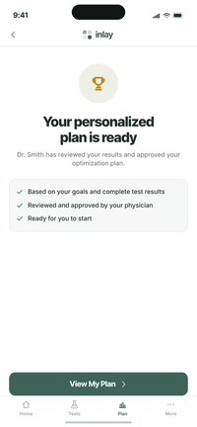
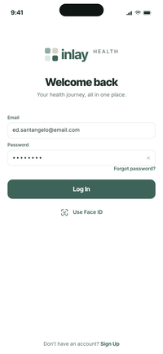
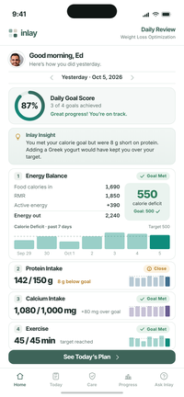
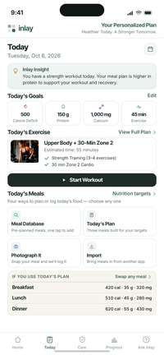
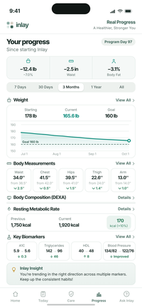
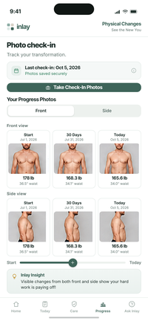
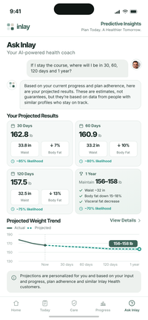
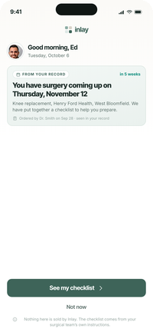
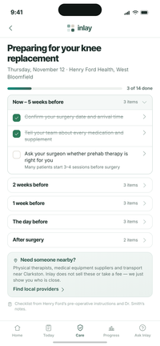
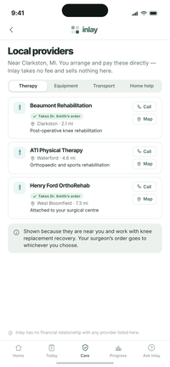
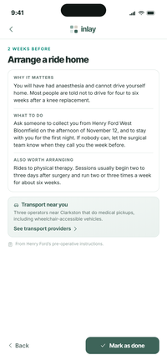
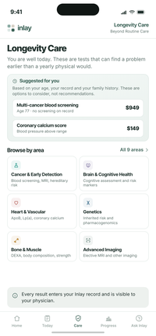
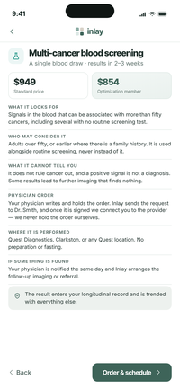
OPTIMIZATION PROGRAM
The Patient Journey
Twenty-three screens, from the first look at the program to the morning Inlay sees what is coming next.
01 Enroll & Set Up
02 Baseline Testing
03 Plan Creation & Approval
04 Daily Use
05 Inlay Care
23 screens · 5 stages
Internal discussion draft · October 2026
Screen content and figures carried forward from the existing mobile set

Slide 2

The journey end to end
Five stages. The patient is never asked to do work the record can do for them.
01
02
03
04
05
ENROLL & SET UP
BASELINE TESTING
PLAN CREATION & APPROVAL
DAILY USE
INLAY CARE
Seven screens from first look to paid enrollment. The patient sees their own data before they see the price.
Inlay places the orders, takes payment, books the appointments and tracks the results.
Generated from complete results, then approved by the patient's own physician — no appointment.
Six screens that run every day: yesterday's score, today's plan, progress, photographs and the projection.
Free surgery support — a checklist and a local directory — alongside Longevity Care, which stays a paid product.
›
›
›
›
1
2
3
4
12
13
14
18
19
20
8
9
10
11
5
6
7
15
16
17
21
22
23
INLAY HEALTH · OPTIMIZATION PATIENT JOURNEY
OVERVIEW
2

Slide 3
STAGE 01
Enroll & Set Up
1
2
3
4
Seven screens from first look to paid enrollment. The patient never fills in a form from scratch, and sees their own health data before they see the price.
Screens 1–7
5
6
7

Slide 4
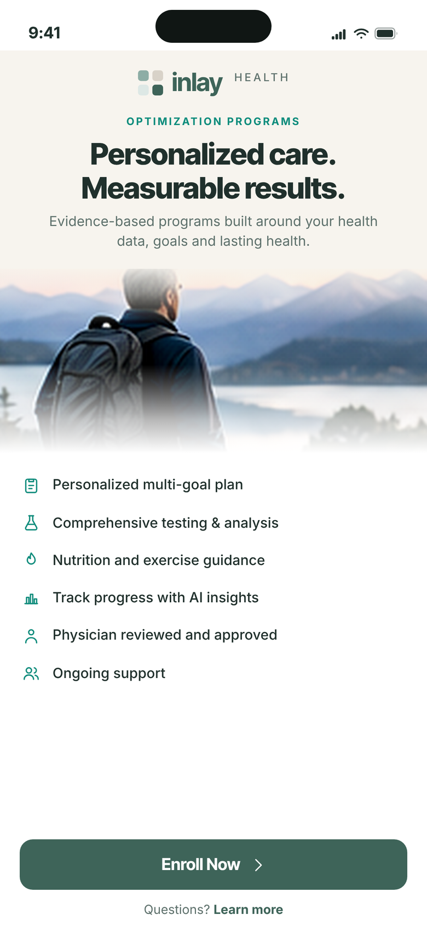
01
STAGE 01 · ENROLL & SET UP
Program Introduction
The offer, in one screen
The patient arrives from their practice already inside their own record. The first screen says what the program is and what it includes — nothing to configure, nothing to read twice.
Six promises and no price yet; the price comes after the patient has seen their own data
“Enroll Now” is the only action — “Learn more” catches the undecided without competing
Physician review sits in the feature list, because that is what separates this from a consumer app
INLAY HEALTH · OPTIMIZATION PATIENT JOURNEY
SCREEN 1 OF 23
4

Slide 5
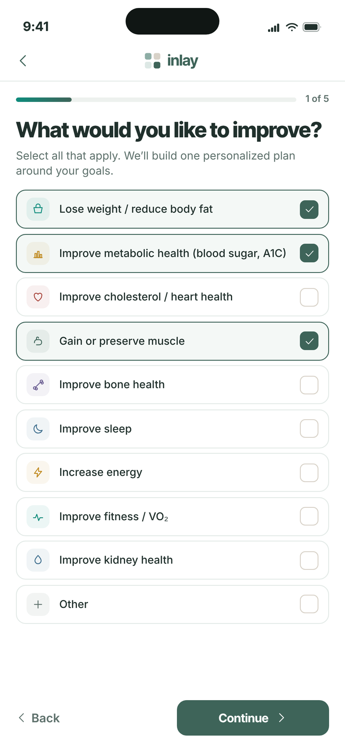
02
STAGE 01 · ENROLL & SET UP
Select Your Goals
Goals first, not a questionnaire
Ten goals, multi-select. The patient tells us what they want before we tell them anything about themselves.
Three selected here: lose weight / reduce body fat, improve metabolic health, gain or preserve muscle
Multi-select means one plan serves several goals rather than forcing a single named program
Step 1 of 5 — the whole set-up is five screens, and the progress bar says so from the start
INLAY HEALTH · OPTIMIZATION PATIENT JOURNEY
SCREEN 2 OF 23
5

Slide 6
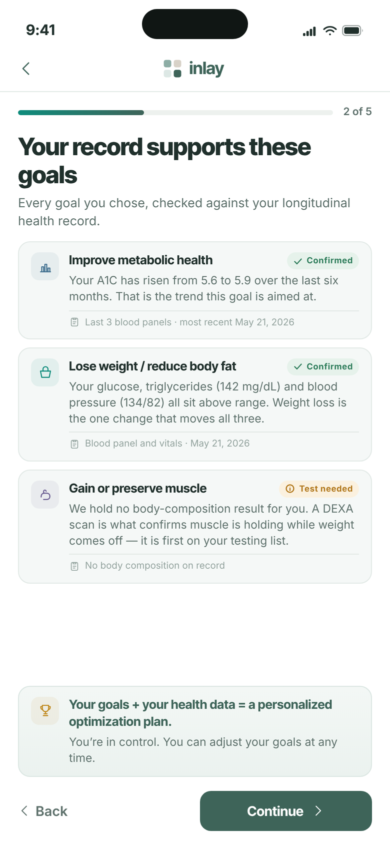
03
STAGE 01 · ENROLL & SET UP
Your Data Insights
The record says the goal is right
Each goal the patient chose is checked against their own longitudinal record. This confirms a decision they have already made rather than selling them one — and it is the screen a consumer application cannot build.
A1C up from 5.6 to 5.9 in six months confirms the metabolic goal; triglycerides at 142 mg/dL and blood pressure at 134/82 confirm the weight goal
Every card cites where the evidence came from and when, so the patient can see it is their own data and not a generic profile
No DEXA result is claimed. Most patients have not had one at enrollment — which is exactly why it is the first required test on the next screen
INLAY HEALTH · OPTIMIZATION PATIENT JOURNEY
SCREEN 3 OF 23
6

Slide 7

04
STAGE 01 · ENROLL & SET UP
Health & Lifestyle
Confirm, don’t fill in
Fifteen fields pre-filled from the Inlay record. The patient confirms or edits. They do not type their history into a blank form.
Age 77 · 166 lb · 35.0 in waist · 3 medications — all of it already known
An Edit link on each block keeps the record the patient’s rather than ours
This is the step at which a form-based competitor loses the patient
INLAY HEALTH · OPTIMIZATION PATIENT JOURNEY
SCREEN 4 OF 23
7

Slide 8
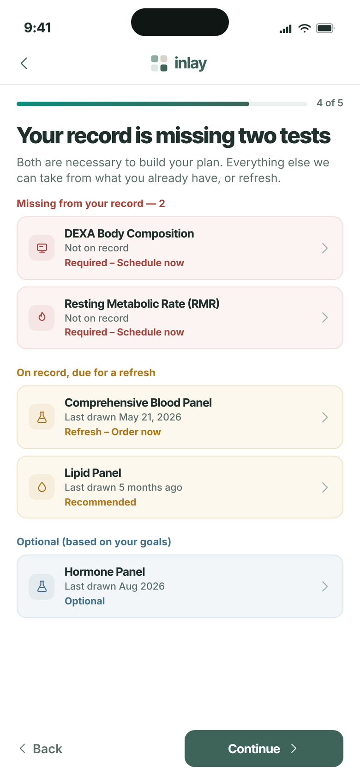
05
STAGE 01 · ENROLL & SET UP
Required Baseline Testing
Two tests you don’t have
The screen does not open with a list of tests to buy. It opens with the gap between what the record already holds and what the plan needs, which is a different and far more persuasive thing.
DEXA body composition and resting metabolic rate are not on record — both are required before a plan can be built
The comprehensive blood panel is on record from May 21, 2026 and is refreshed rather than repeated, so nobody is asked to redo work already done
Stating the gap one screen before the price makes the $99 read as measurement rather than as a subscription
INLAY HEALTH · OPTIMIZATION PATIENT JOURNEY
SCREEN 5 OF 23
8

Slide 9
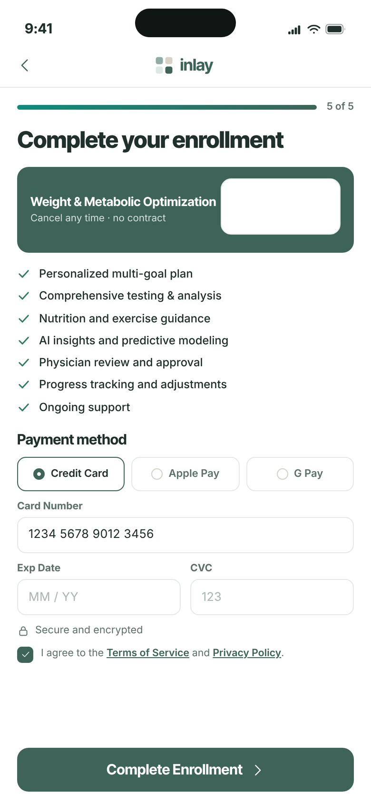
06
STAGE 01 · ENROLL & SET UP
Payment & Enrollment
$99 a month, once the value is visible
The price appears on screen six, after the patient has seen their own data and the testing their plan will be built on.
Seven inclusions restated at the moment of payment, where objections actually happen
Credit card, Apple Pay and Google Pay; monthly, cancel any time, no contract
Step 5 of 5 — enrollment closes the set-up sequence rather than opening a new one
INLAY HEALTH · OPTIMIZATION PATIENT JOURNEY
SCREEN 6 OF 23
9

Slide 10
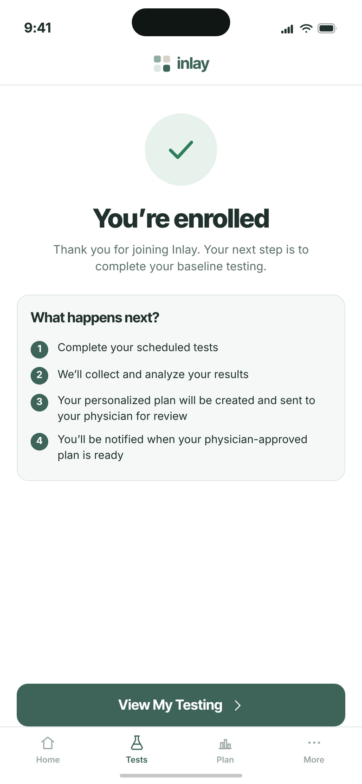
07
STAGE 01 · ENROLL & SET UP
Enrollment Confirmed
Four steps, then the plan
The patient leaves the purchase knowing exactly what happens next, in what order, and who does it.
The physician review is named here, before it happens, so it is never a surprise
“View My Testing” moves straight to the next action instead of ending the session
The tab bar appears for the first time — the patient is now inside the product
INLAY HEALTH · OPTIMIZATION PATIENT JOURNEY
SCREEN 7 OF 23
10

Slide 11
STAGE 02
Baseline Testing
Inlay places the orders, takes the payment and books the appointments, then tracks the results. The patient buys the test inside the app and never chases a laboratory.
Screens 8–9
8
9

Slide 12
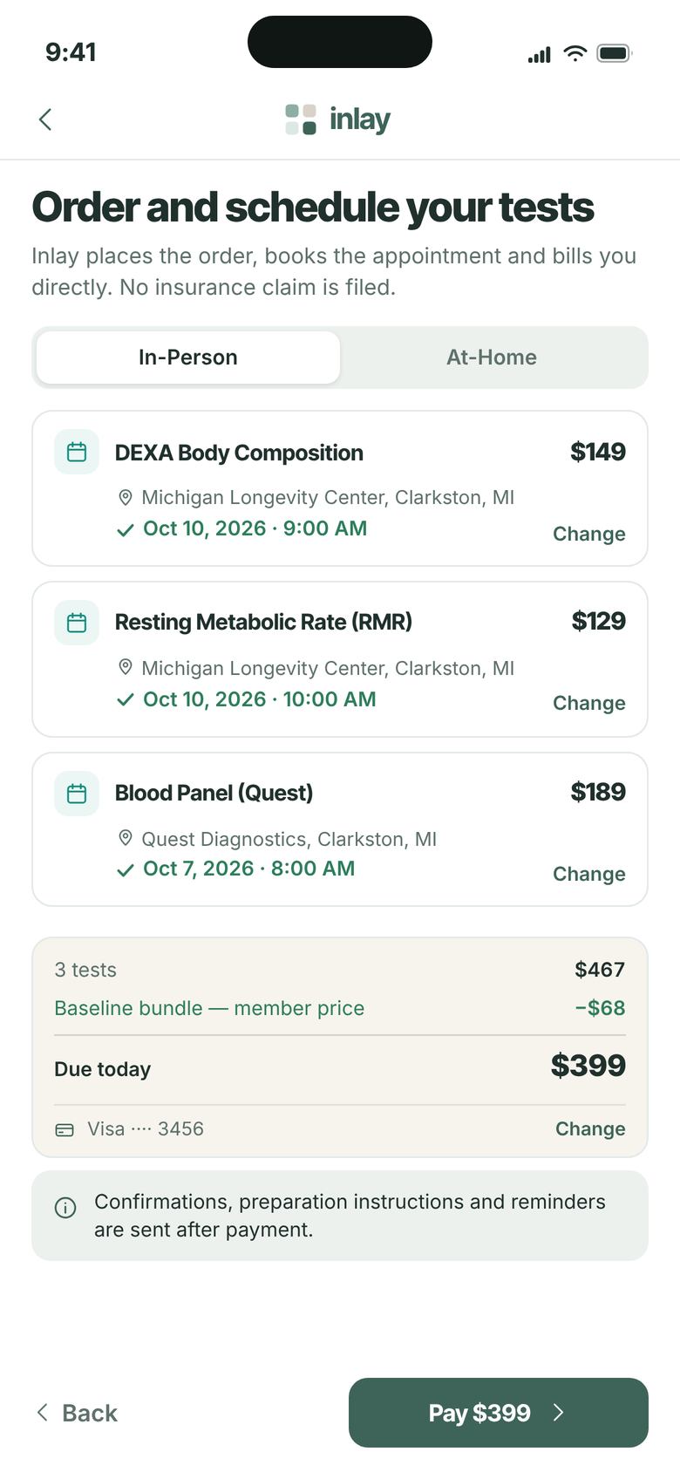
08
STAGE 02 · BASELINE TESTING
Order & Schedule Your Tests
The tests are bought here
DEXA and RMR are ordered, paid for and booked inside the app. Inlay buys from the supplier and sells to the patient, so there is no insurance claim to file and nothing for the practice to collect.
$149 DEXA, $129 RMR, $189 comprehensive panel — $467 of testing, bundled at $399 for the member
Michigan Longevity Center for DEXA and RMR, Quest Diagnostics for the panel; Inlay places all three orders
Cash only, with no claim filed — the condition that keeps the testing line clear of federal referral exposure
INLAY HEALTH · OPTIMIZATION PATIENT JOURNEY
SCREEN 8 OF 23
12

Slide 13

09
STAGE 02 · BASELINE TESTING
Testing in Progress
Two of three complete
The status screen answers the only question a patient has between booking and results.
DEXA and RMR completed; blood panel results expected in 1–2 days
A progress bar plus per-test state — no chasing, no calling the practice
A notification is promised, so the patient has no page to keep re-checking
INLAY HEALTH · OPTIMIZATION PATIENT JOURNEY
SCREEN 9 OF 23
13

Slide 14
STAGE 03
Plan Creation & Approval
The plan is generated from complete results and approved by the patient's own physician — asynchronously, with no appointment required.
Screens 10–11
10
11

Slide 15
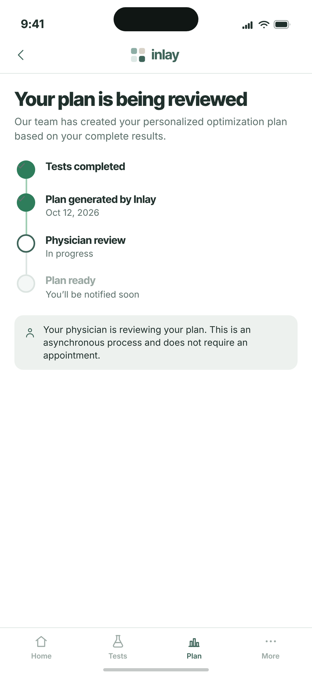
10
STAGE 03 · PLAN CREATION & APPROVAL
Physician Review
The physician is in the loop, asynchronously
Four stages, all visible. The review requires no appointment and no further effort from the patient.
Tests completed → plan generated Oct 12, 2026 → physician review → plan ready
The asynchronous nature of the review is stated plainly, so nobody waits for a visit
This is the screen that separates Inlay from an unsupervised wellness app
INLAY HEALTH · OPTIMIZATION PATIENT JOURNEY
SCREEN 10 OF 23
15

Slide 16
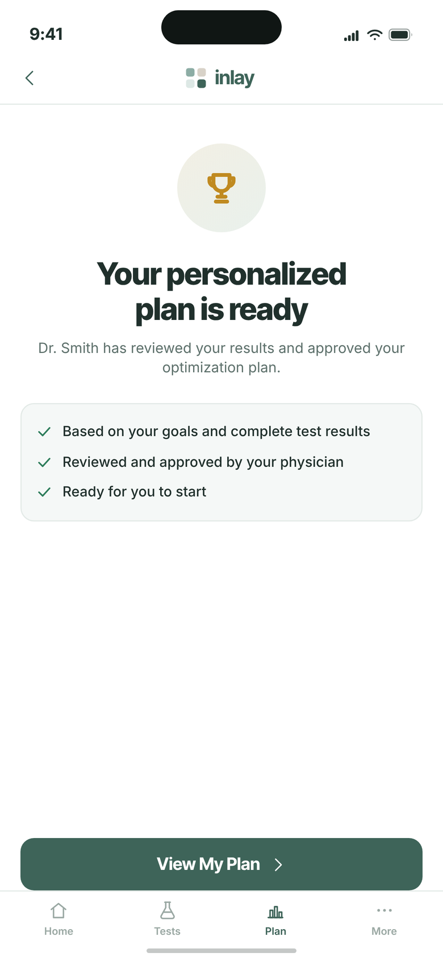
11
STAGE 03 · PLAN CREATION & APPROVAL
Your Plan Is Ready
Approved, and attributed
The plan arrives with the physician’s name attached to it.
Built on the goals the patient chose and the complete set of test results
Reviewed and approved by the patient’s own physician, not by a platform clinician
One action on the screen: View My Plan
INLAY HEALTH · OPTIMIZATION PATIENT JOURNEY
SCREEN 11 OF 23
16

Slide 17
STAGE 04
Daily Use
12
13
14
Six screens that run every day: yesterday's score, today's plan, measured progress, photographic evidence and the projection that renews the subscription.
Screens 12–17
15
16
17

Slide 18

12
STAGE 04 · DAILY USE
Log In
The returning patient
From here on the app is a daily habit rather than an onboarding flow.
Face ID carries the daily open; email and password remain for first set-up and recovery
Everything after this screen is what the $99 a month actually buys
The same account holds the free record layer and the paid optimization program
INLAY HEALTH · OPTIMIZATION PATIENT JOURNEY
SCREEN 12 OF 23
18

Slide 19

13
STAGE 04 · DAILY USE
Yesterday: How Did I Do?
The first screen every morning
One score, one insight and four goals — the whole of yesterday in a single screen, with no scrolling required.
87% daily goal score, 3 of 4 goals achieved
Energy balance reconciles on screen: 2,240 kcal out, 1,690 in, a 550 deficit against a 500 goal
The insight names the one miss — 8 g of protein — and what would have closed it
INLAY HEALTH · OPTIMIZATION PATIENT JOURNEY
SCREEN 13 OF 23
19

Slide 20
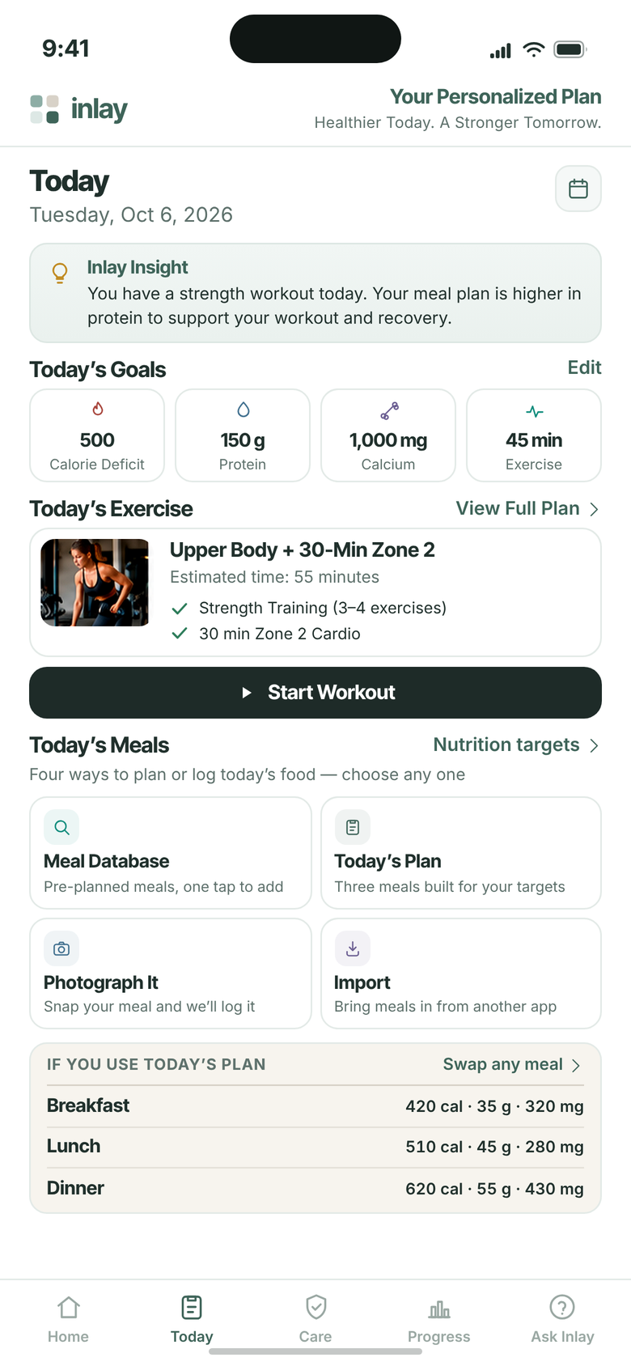
14
STAGE 04 · DAILY USE
Today: Personalized Plan
Four ways to eat the plan
A fixed menu is the fastest way to lose a patient. The day’s targets stay fixed — 500 cal deficit, 150 g protein, 1,000 mg calcium, 45 min exercise — but the food itself can come from four different places.
Meal database and today’s plan both add in one tap, already costed in calories, protein and calcium
Photograph It covers the meal that was never in anyone’s plan; Import takes the patient who already tracks elsewhere
The built plan stays visible but optional: breakfast 420 cal, lunch 510, dinner 620, with any meal swappable
INLAY HEALTH · OPTIMIZATION PATIENT JOURNEY
SCREEN 14 OF 23
20

Slide 21
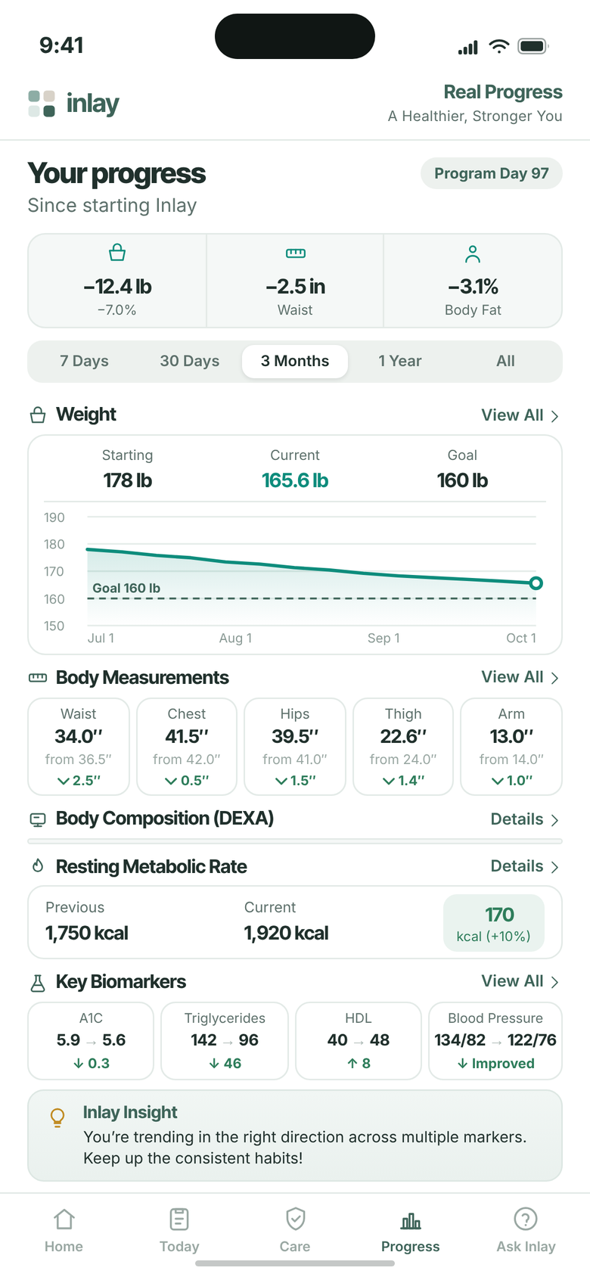
15
STAGE 04 · DAILY USE
Progress
Day 97
The screen the patient shows other people — and the one that renews the subscription.
−12.4 lb, −2.5 in at the waist, −3.1% body fat since starting
Biomarkers moved: A1C 5.9→5.6, triglycerides 142→96, HDL 40→48, BP 134/82→122/76
RMR up 170 kcal (+10%) — measured proof that lean mass was preserved through the loss
INLAY HEALTH · OPTIMIZATION PATIENT JOURNEY
SCREEN 15 OF 23
21

Slide 22

16
STAGE 04 · DAILY USE
Photo Check-In
Evidence they can see
Front and side, three dates, with weight and waist under each frame.
Jul 1 — 178 lb · Jul 31 — 168.3 lb · Oct 5 — 165.6 lb
Photographs stored securely; the comparison slider is the moment patients share
Visible change is what holds a subscription together when the scale stalls
INLAY HEALTH · OPTIMIZATION PATIENT JOURNEY
SCREEN 16 OF 23
22

Slide 23
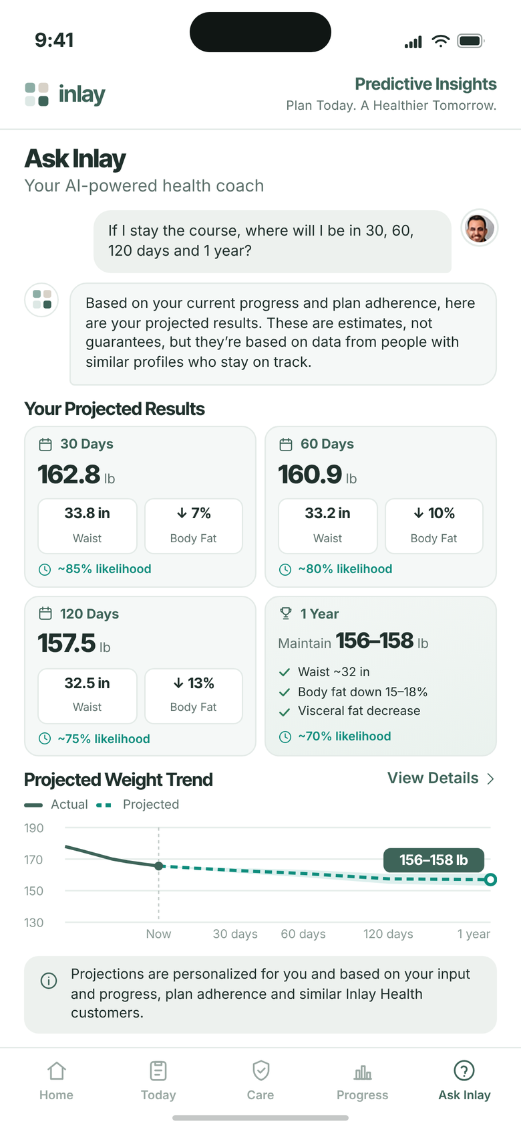
17
STAGE 04 · DAILY USE
Ask Inlay — Predictive Insights
Where this goes if they stay
The retention screen. It answers the question every patient asks at month three.
30 days 162.8 lb · 60 days 160.9 lb · 120 days 157.5 lb · 1 year maintain 156–158 lb
Every projection carries a likelihood: 85%, 80%, 75% and 70%
Framed as estimates drawn from similar patients, never as a promise
INLAY HEALTH · OPTIMIZATION PATIENT JOURNEY
SCREEN 17 OF 23
23

Slide 24
STAGE 05
Inlay Care
18
19
20
The app sees the surgery in the record and hands the patient a checklist drawn from their own surgical team’s instructions, with a directory of who is nearby. None of that is sold. Longevity Care, the elective screening catalogue, remains a paid Inlay product.
Screens 18–23
21
22
23

Slide 25

18
STAGE 05 · INLAY CARE
First Screen — Surgery Detected
Proof that we know them
When Inlay sees the surgery in the record, this takes the screen before Home. It says one thing, and that one thing is the whole argument for the free record.
“You have surgery coming up on Thursday, November 12” — named, dated, five weeks ahead
Ordered by Dr. Smith on Sep 28, and the screen says so, because the source is what makes it credible
Nothing is sold here. The line under the button says the checklist comes from the surgical team, not from us
INLAY HEALTH · OPTIMIZATION PATIENT JOURNEY
SCREEN 18 OF 23
25

Slide 26
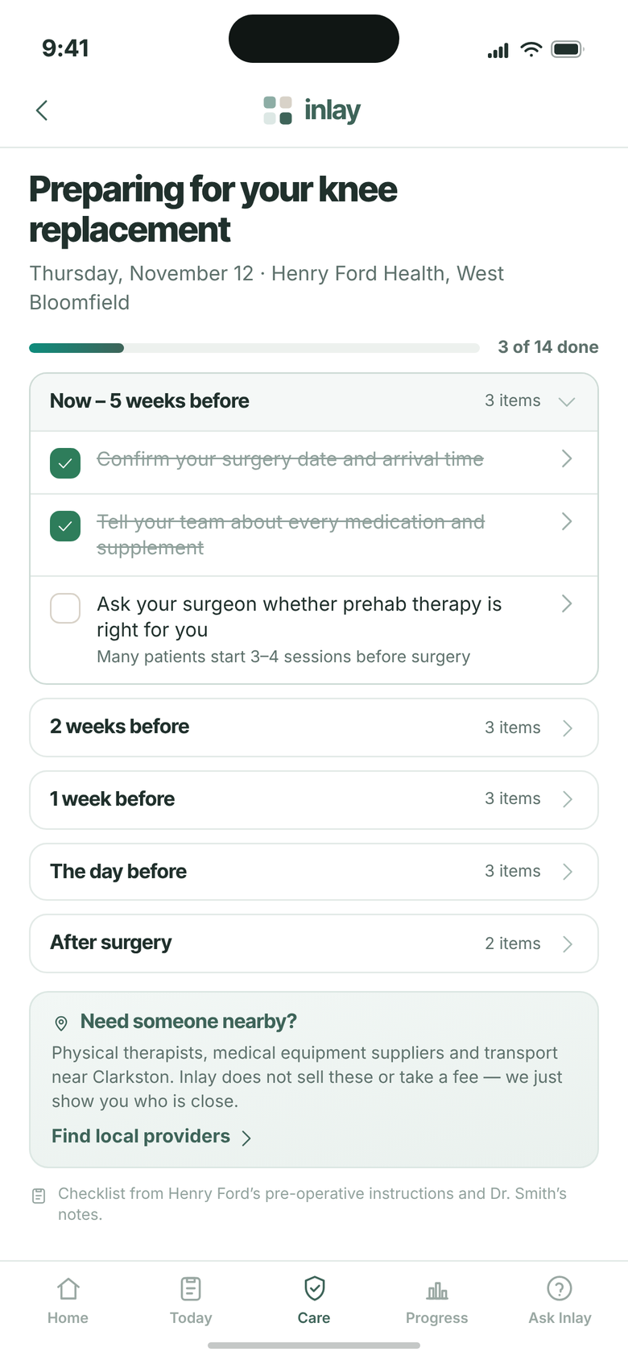
19
STAGE 05 · INLAY CARE
Preparation Checklist
Fourteen things, in the right order
Grouped by when each one matters rather than listed flat, so the patient sees the three things to do now instead of a wall of instructions five weeks early.
3 of 14 done, with the current group open and the rest collapsed until their time comes
The content is Henry Ford’s own pre-operative instructions and Dr. Smith’s notes — Inlay carries it, Inlay did not write it
One box at the foot for local providers, worded as help rather than as a storefront
INLAY HEALTH · OPTIMIZATION PATIENT JOURNEY
SCREEN 19 OF 23
26

Slide 27
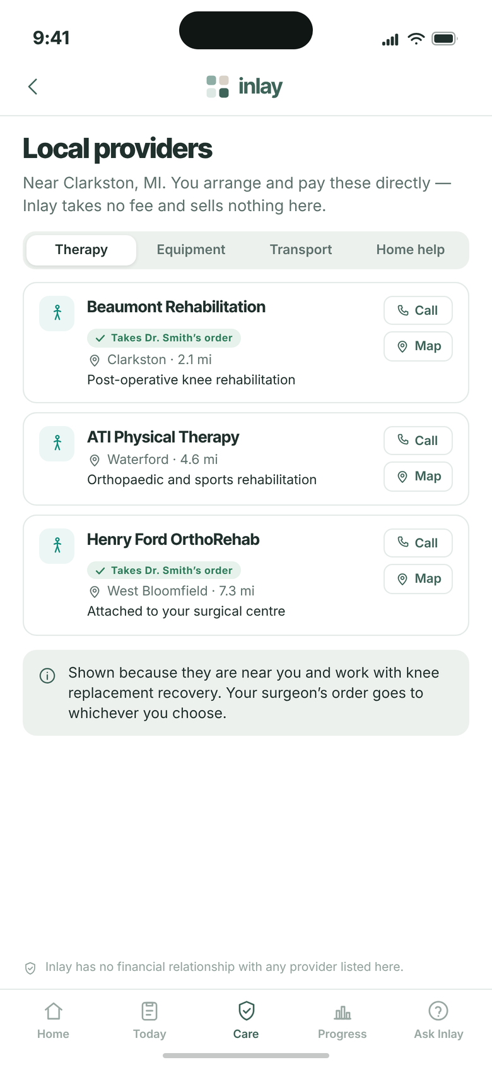
20
STAGE 05 · INLAY CARE
Local Providers
Who is nearby, and nothing else
Therapy, equipment, transport and home help near Clarkston. The patient arranges and pays directly; Inlay takes no fee and never touches the transaction.
Two of the three clinics already accept Dr. Smith’s order — the one thing only we would know
Call and Map. No price, no booking, no checkout
“Inlay has no financial relationship with any provider listed here” sits at the foot of the screen
INLAY HEALTH · OPTIMIZATION PATIENT JOURNEY
SCREEN 20 OF 23
27

Slide 28
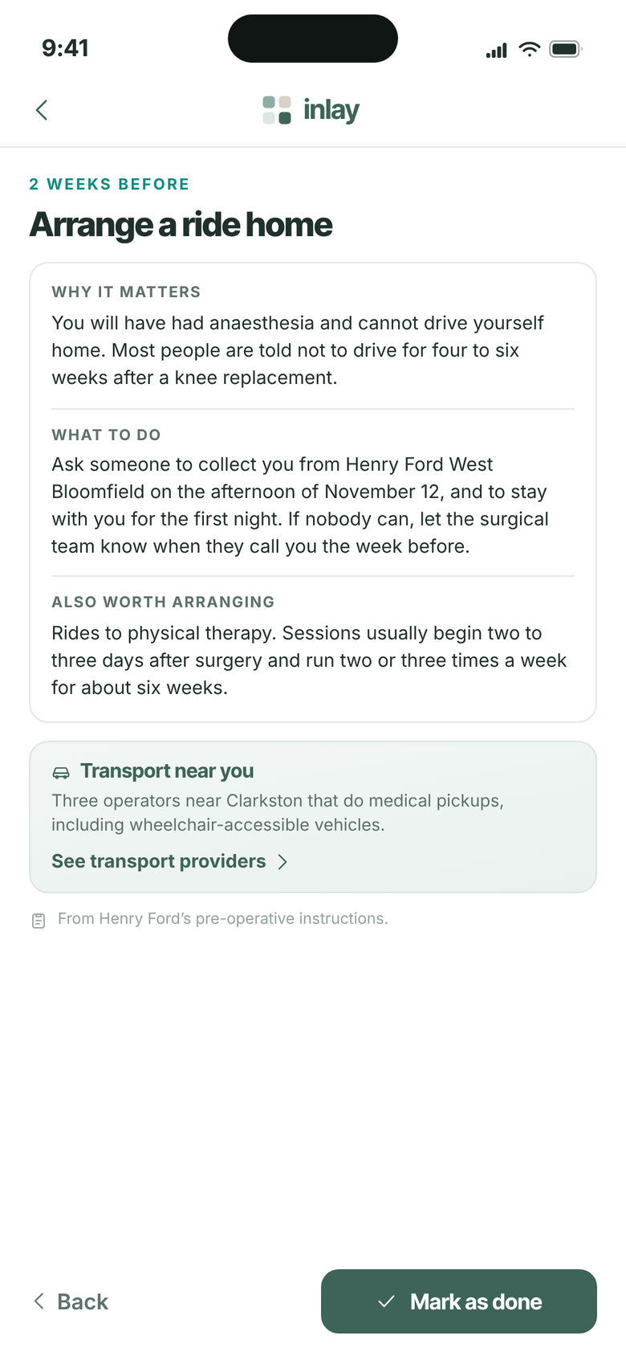
21
STAGE 05 · INLAY CARE
Checklist Item
Why, not just what
Opening an item gives the reason behind it, which is what turns a list of instructions into something a patient actually follows.
Why it matters, what to do, and what else is worth arranging while they are at it
Dated and specific: collected from Henry Ford West Bloomfield on the afternoon of November 12
The transport box appears here too, because this is the moment the patient needs it
INLAY HEALTH · OPTIMIZATION PATIENT JOURNEY
SCREEN 21 OF 23
28

Slide 29
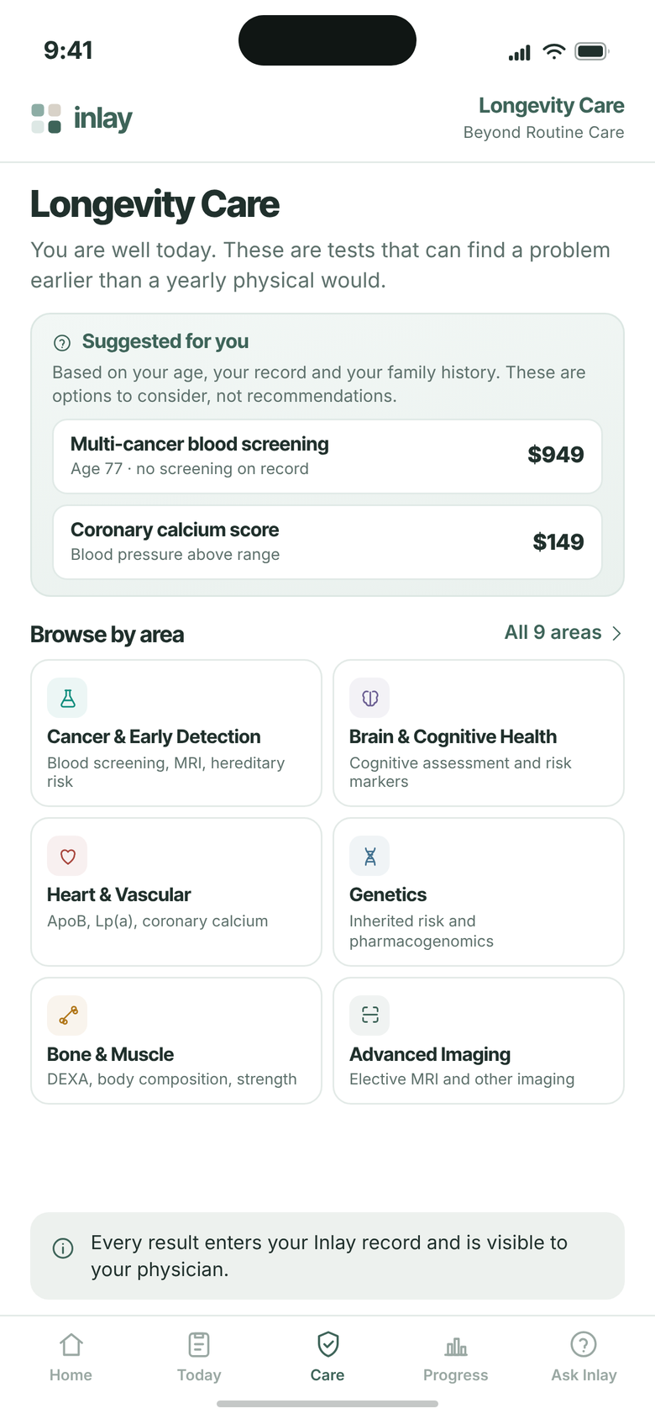
22
STAGE 05 · INLAY CARE
Longevity Care
For the patient who comes looking
The elective side, and the one part of Inlay Care that is still sold. Nothing here is triggered by an event — it is for the well patient who wants to find something early.
“You are well today” is the opening line, which is what makes the rest of the page credible
Suggested for you sits above the catalogue, drawn from age, record and family history
Suggested is worded as options to consider, never as recommendations
INLAY HEALTH · OPTIMIZATION PATIENT JOURNEY
SCREEN 22 OF 23
29

Slide 30
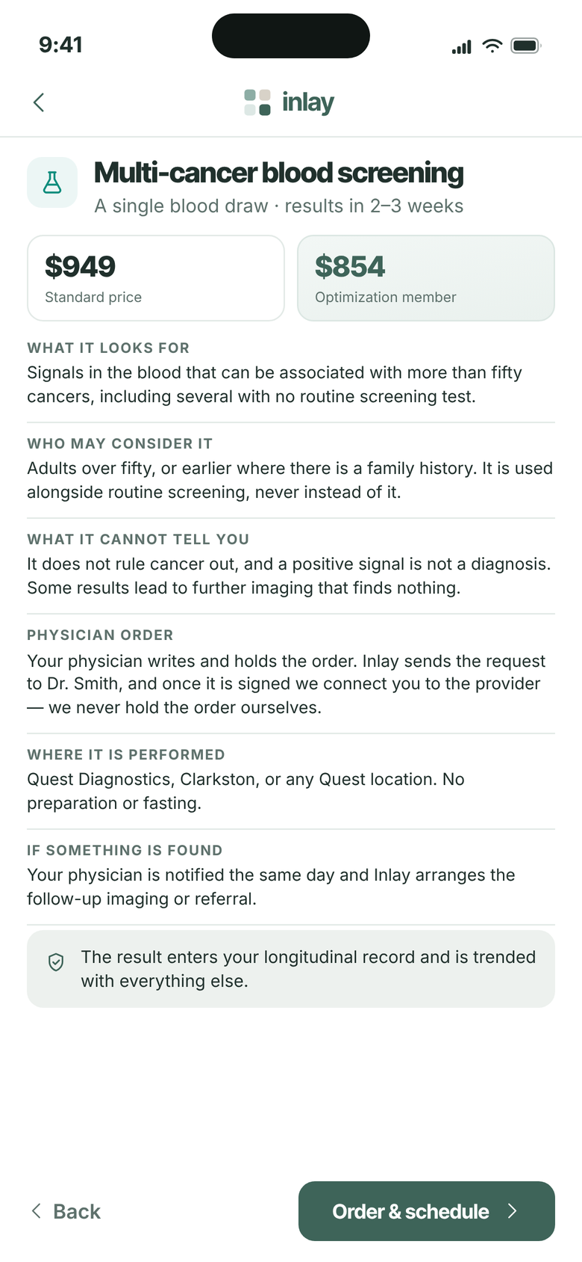
23
STAGE 05 · INLAY CARE
Longevity Care — Test Detail
What it cannot tell you
Every elective test carries the same six disclosures, the limits included. This is the page that protects the brand when a screening result turns out to be nothing.
$949 standard, $854 for members, with the request routed to the physician rather than left to the patient
The physician writes and holds the order; Inlay only connects the patient to the provider
“It does not rule cancer out, and a positive signal is not a diagnosis” sits on the page, not in the terms
INLAY HEALTH · OPTIMIZATION PATIENT JOURNEY
SCREEN 23 OF 23
30

